Slide 1

cloudgeass
cloudgeass
Python library
Python library

Slide 2
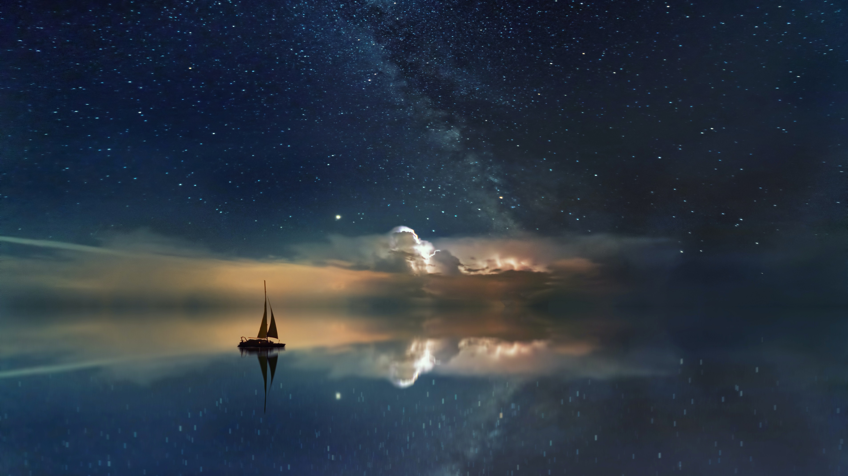
cloudgeass
Python library

Slide 3
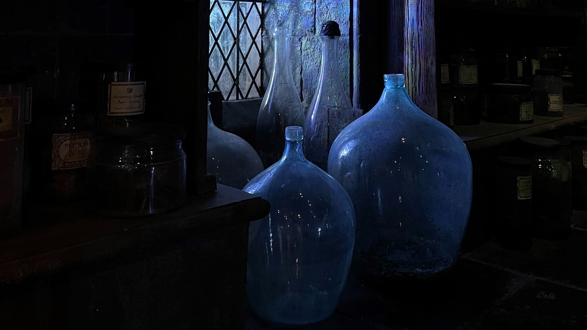
cloudgeass
Python library

Slide 4
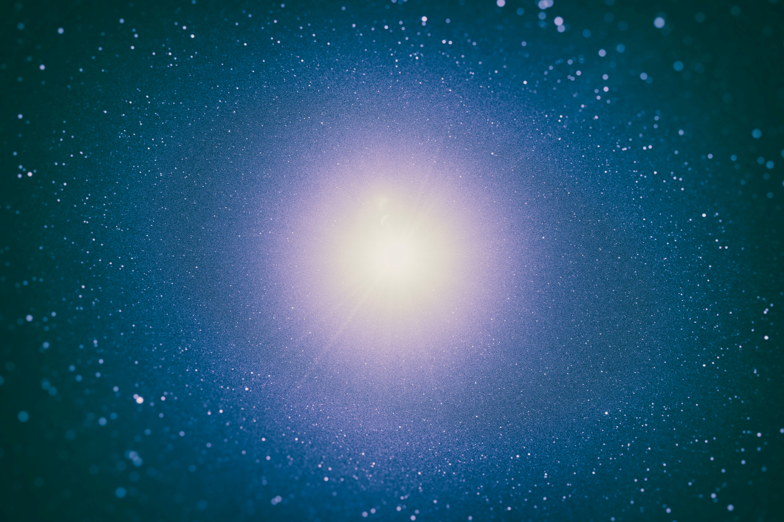
cloudgeass
Python library

Slide 5
cloudgeass
Python library

Slide 6
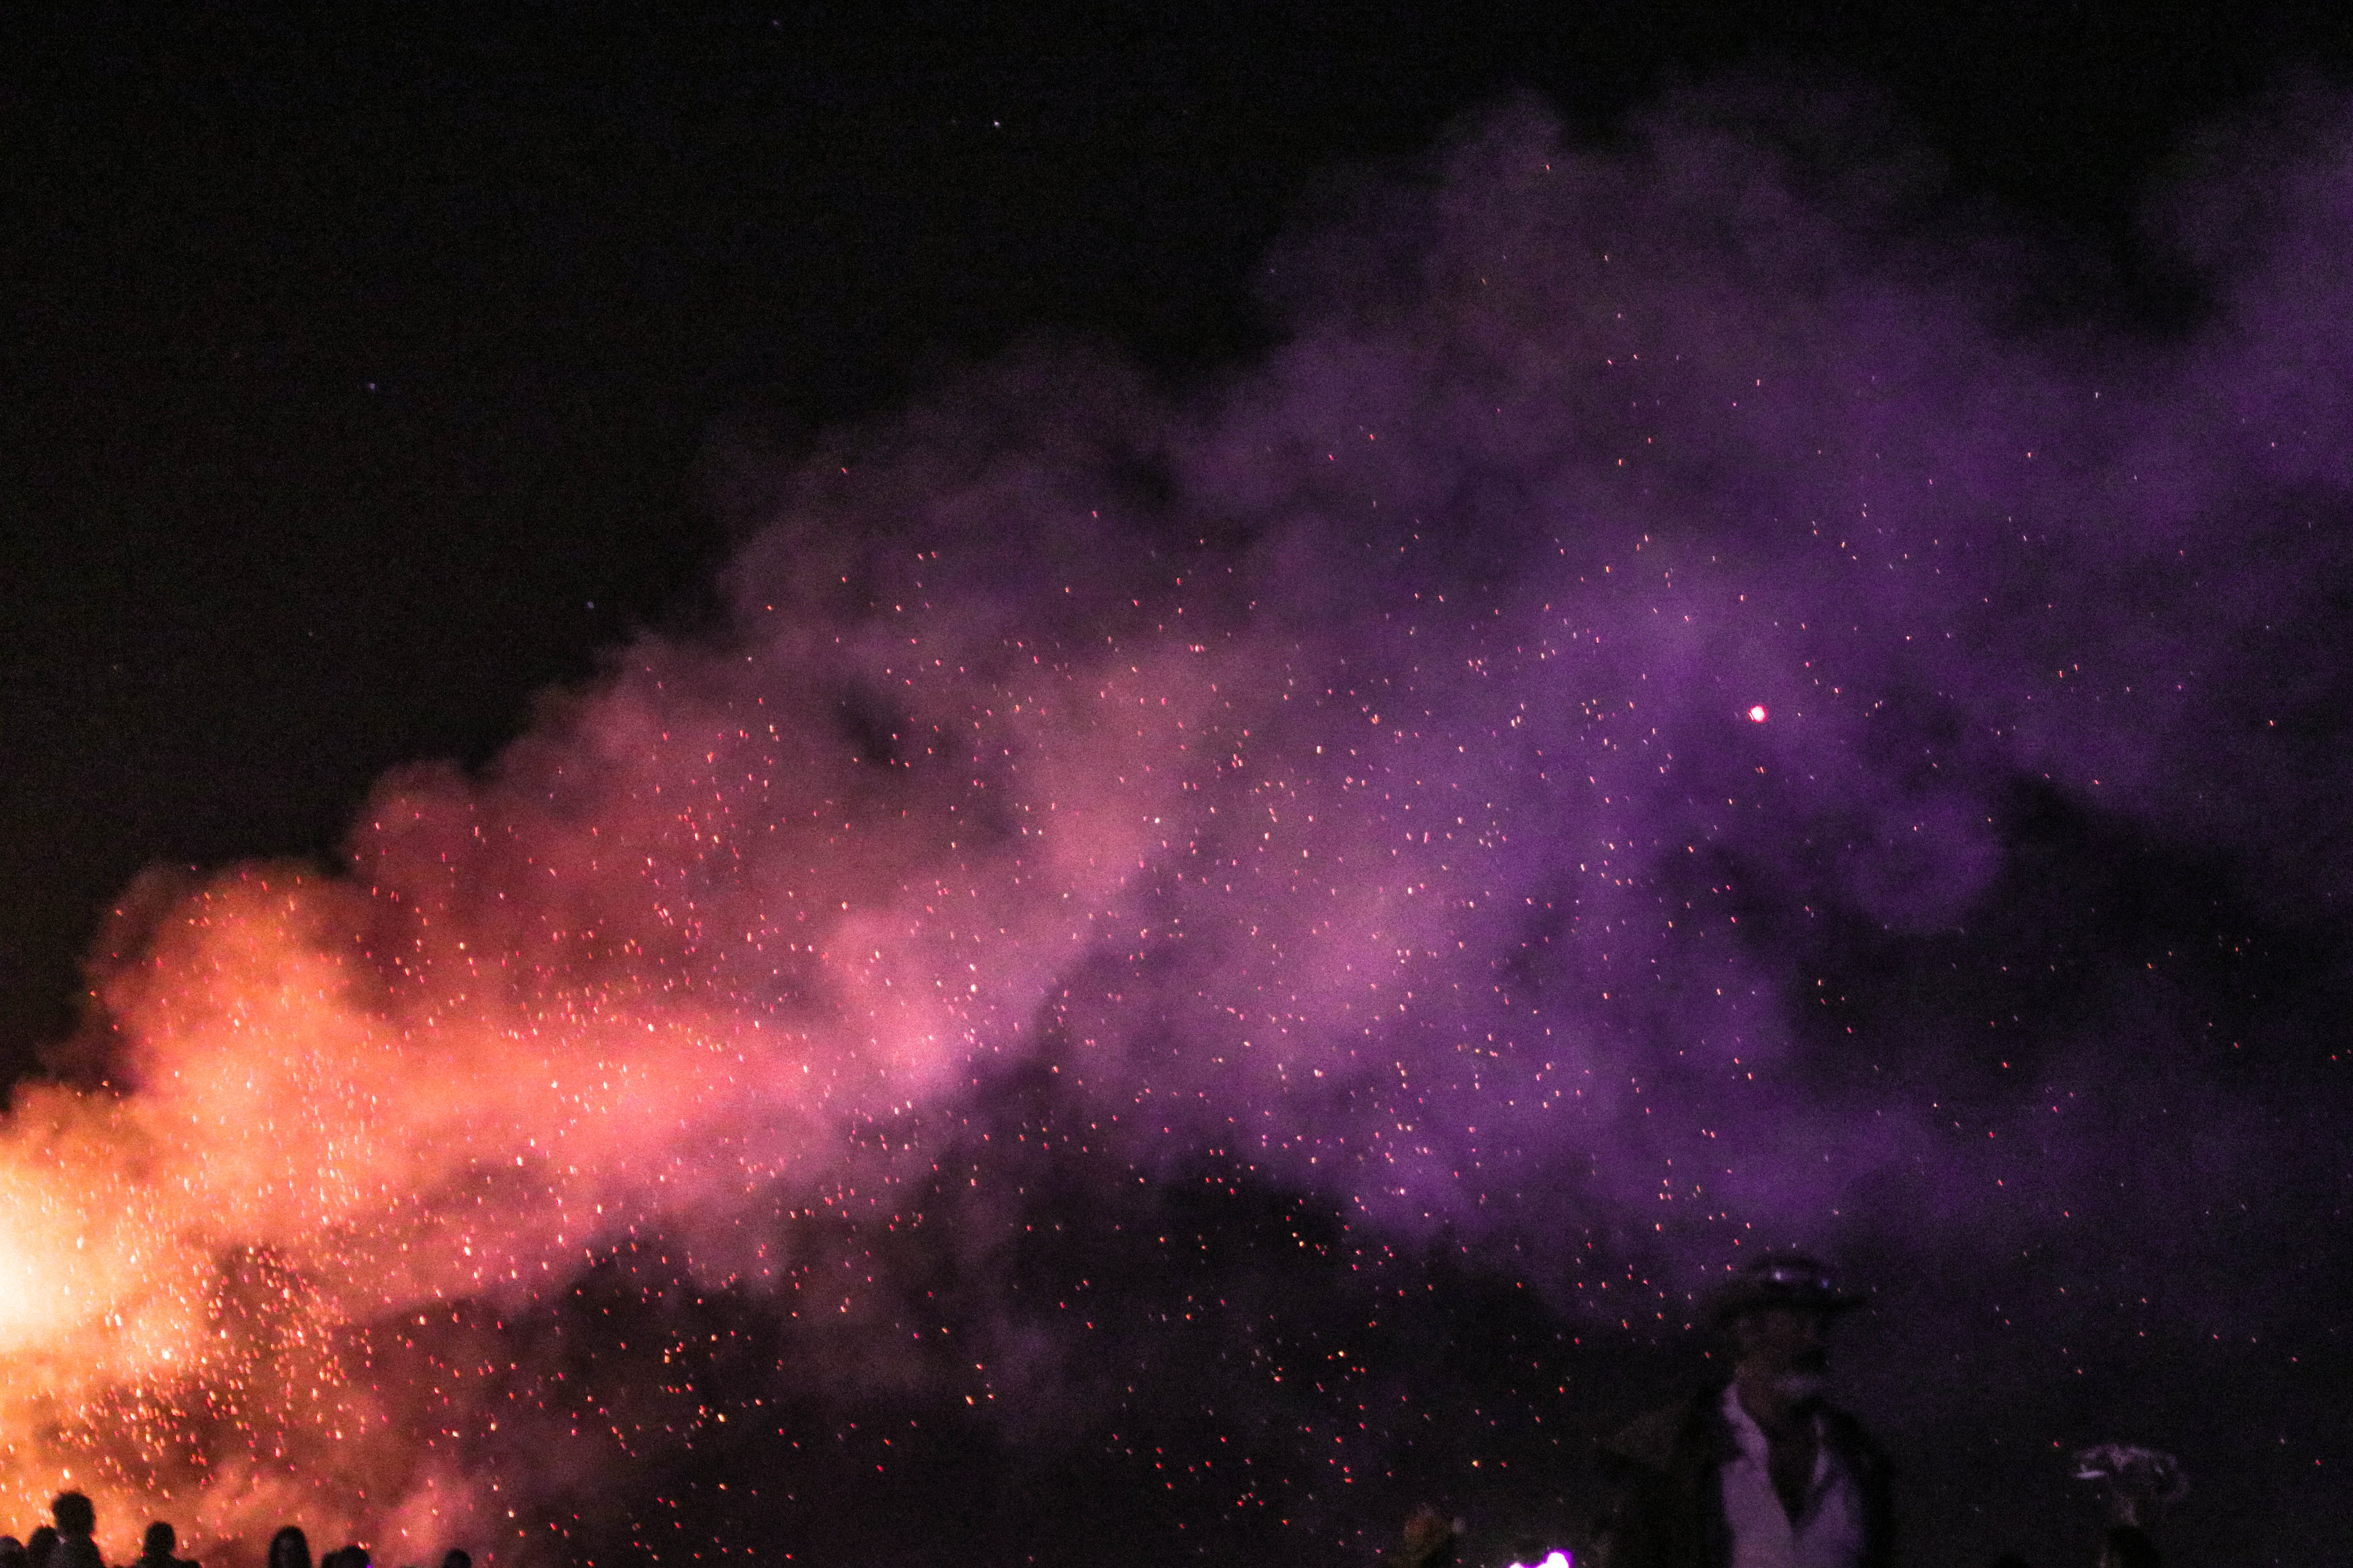
cloudgeass
Python library

Slide 7
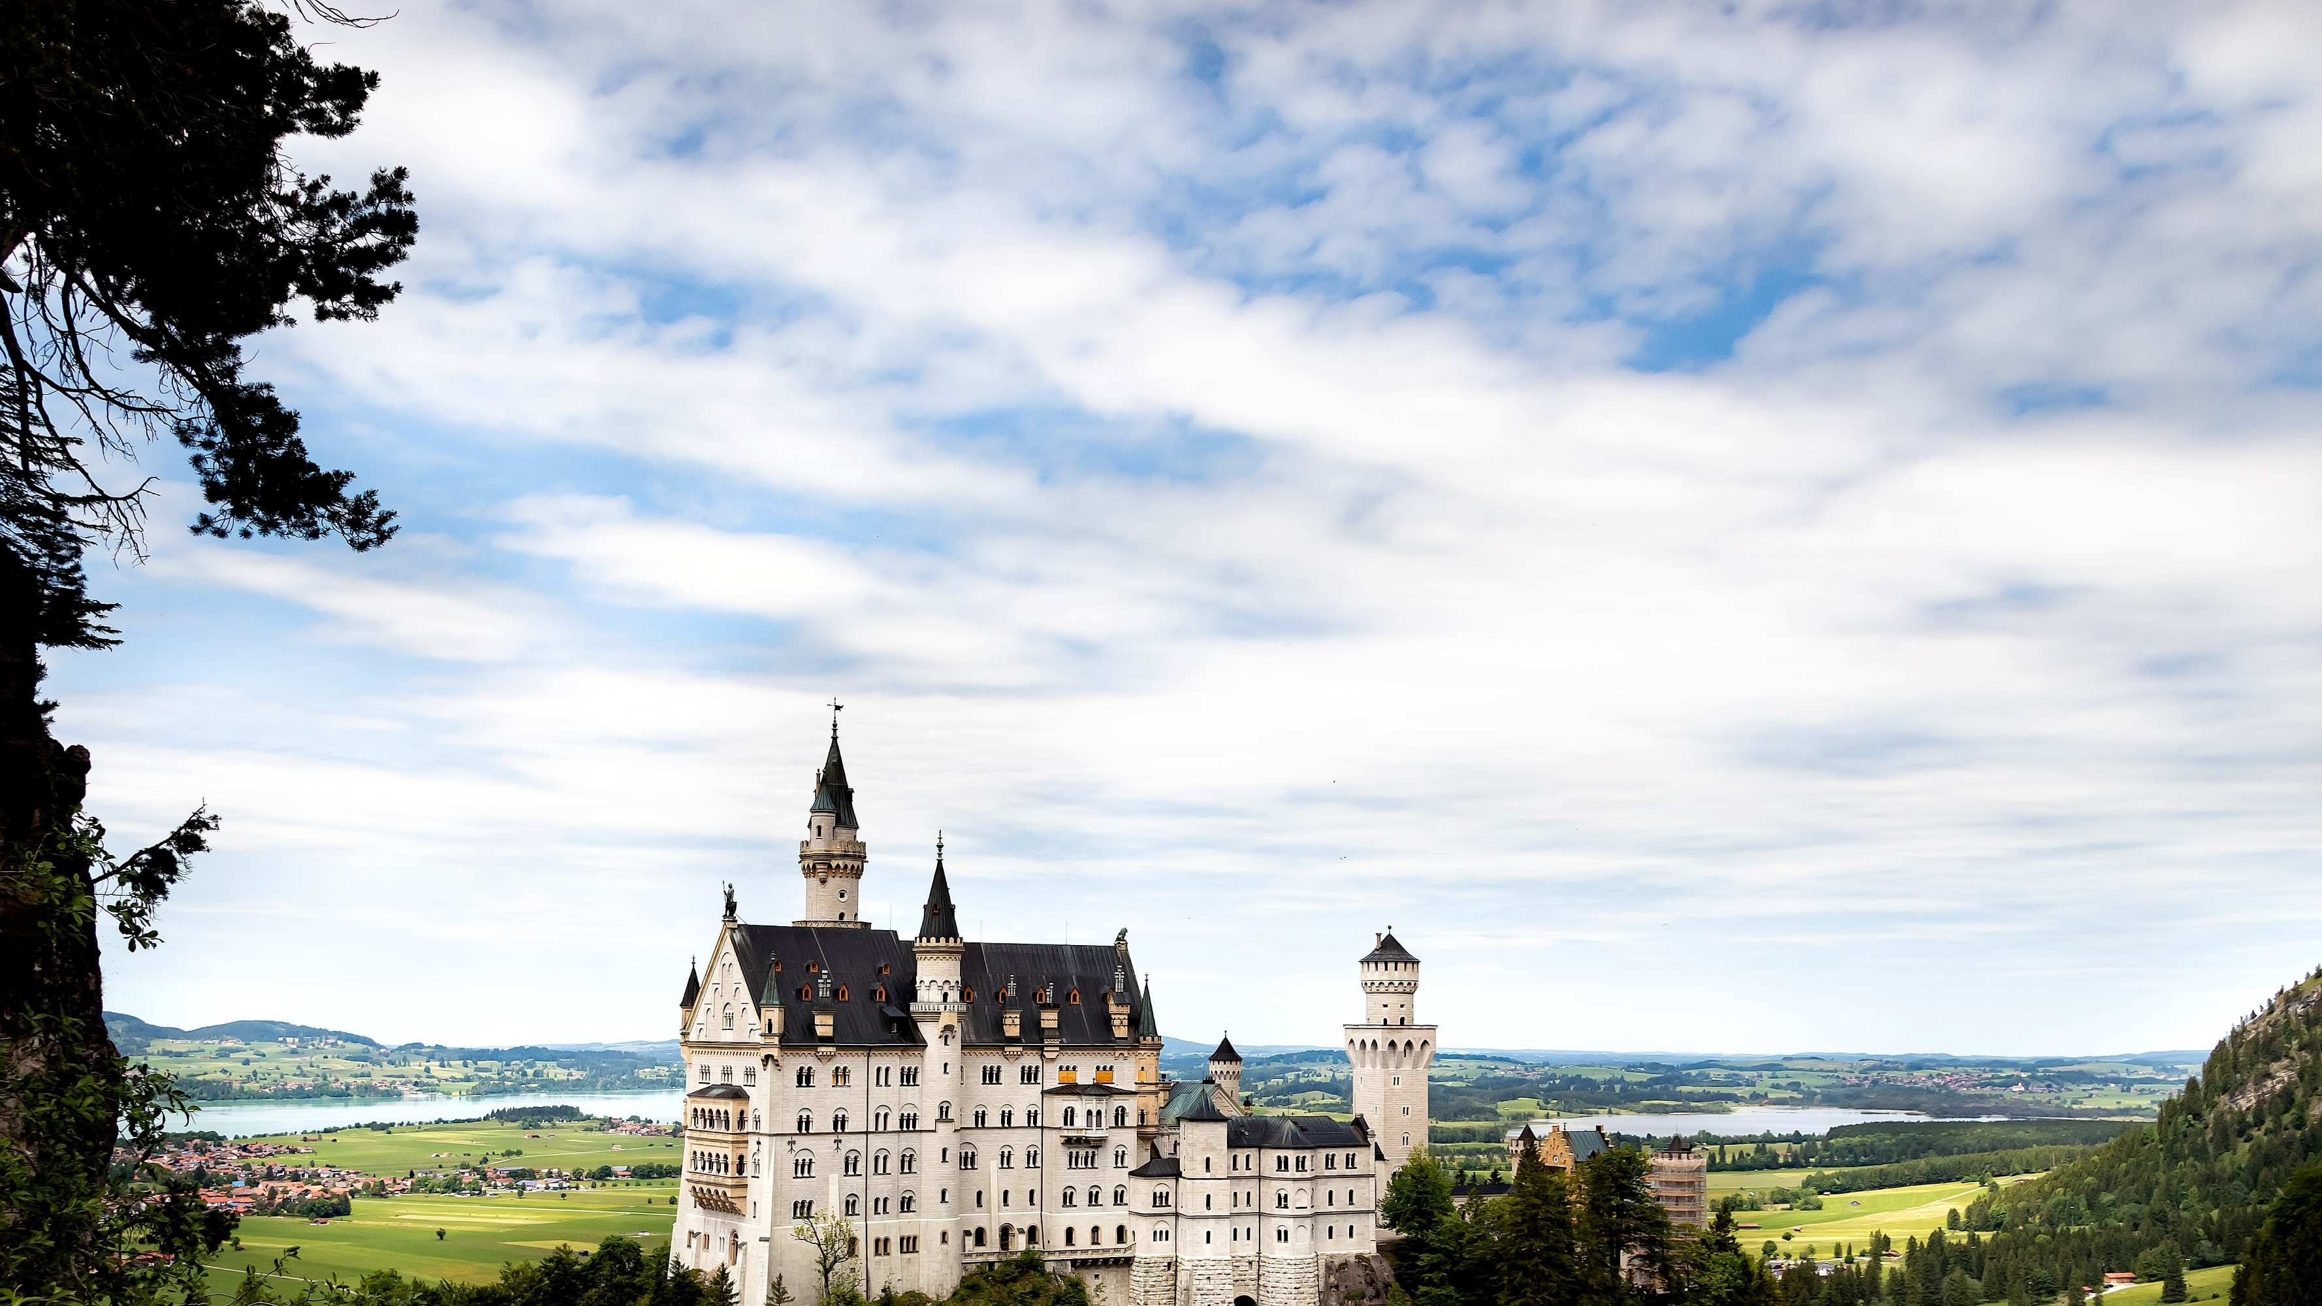
cloudgeass
Python library

Slide 8



Slide 10
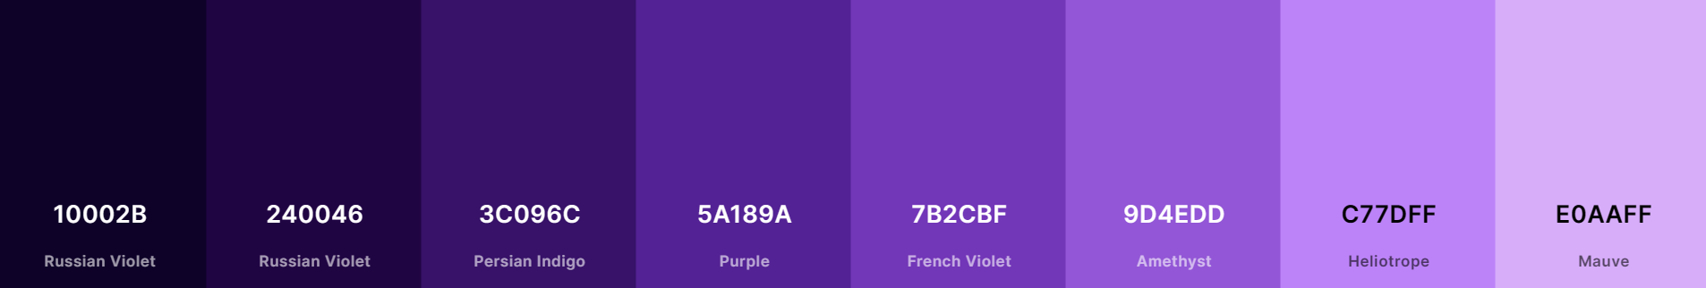
Paleta de Cores | Colorindo materiais
Palavras para lembrar/inspirar
Glue
Terraform
Moon
Galaxy
Universe
Magic
clique para acessar a paleta em coolors.co

